Slide 1
trailer->Play();
Notes:
video

Slide 2
Studio Project 2 Presentation
Team 11
Marcus, Alex, Faizal, Ko Sand, Terence

Slide 3
Overview
> Product Vision
> Project Schedule
> Game Features
> Gameplay Demo
> Problems Faced
> Future Improvements

Slide 4

Product Vision
Notes:
Introduce name of game

Slide 5
Product Vision
Third-person racing game
Vehicles leave behind paint trail
Goal is to cover the map in your paint color
Compete with A.I. which will try to paint their color over your color
The side with more paint on the map at the end wins

Slide 6
Project Schedule - Marcus
Task/Week | Week 1 |  |  |  |  | Week 2 |  |  |  |  | Week 3
Start Menu
Level Selection
Pause Menu
Reticle / Cursor
Collectibles / Power Up
Scene Management
Notes:
Go through these quickly, mention can alr, is for lecturers to see at the end if got question

Slide 7
Project Schedule - Alex
Task/Week | Week 1 |  |  |  |  | Week 2 |  |  |  |  | Week 3
Models
Garage
Timer
Collectibles / Power Up

Slide 8
Project Schedule - Faizal
Task/Week | Week 1 |  |  |  |  | Week 2 |  |  |  |  | Week 3
Third Person Camera
A.I.
Map Generation

Slide 9
Project Schedule - Ko Sand
Task/Week | Week 1 |  |  |  |  | Week 2 |  |  |  |  | Week 3
Car Physics
Gearbox
Results Screen

Slide 10
Project Schedule - Terence
Task/Week | Week 1 |  |  |  |  | Week 2 |  |  |  |  | Week 3
Loading Between Scenes
Paint trail
Area of paint calculation
Collision
FrameWork Stuff

Slide 11
Game Features
Marcus
Notes:
Presenting by person

Slide 12
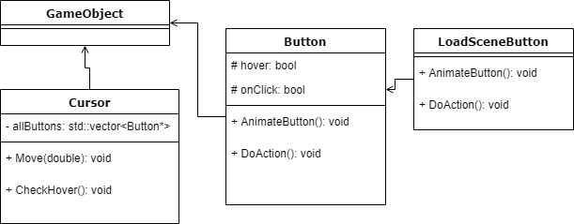
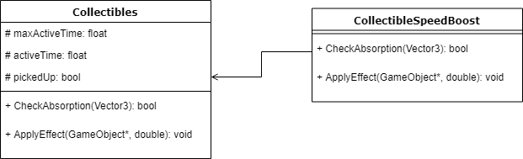
Game Features - Marcus
Cursor
Ui
PowerUps
Notes:
Fill up yourself

Slide 13
Game Features
Alex
Notes:
Presenting by person

Slide 14
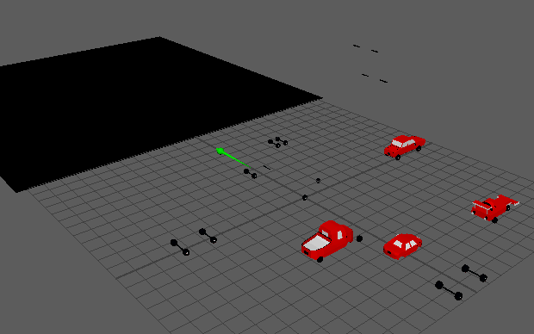
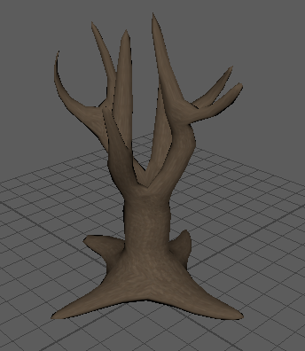
Game features - Alex
3D Modelling/Texturing

Slide 15
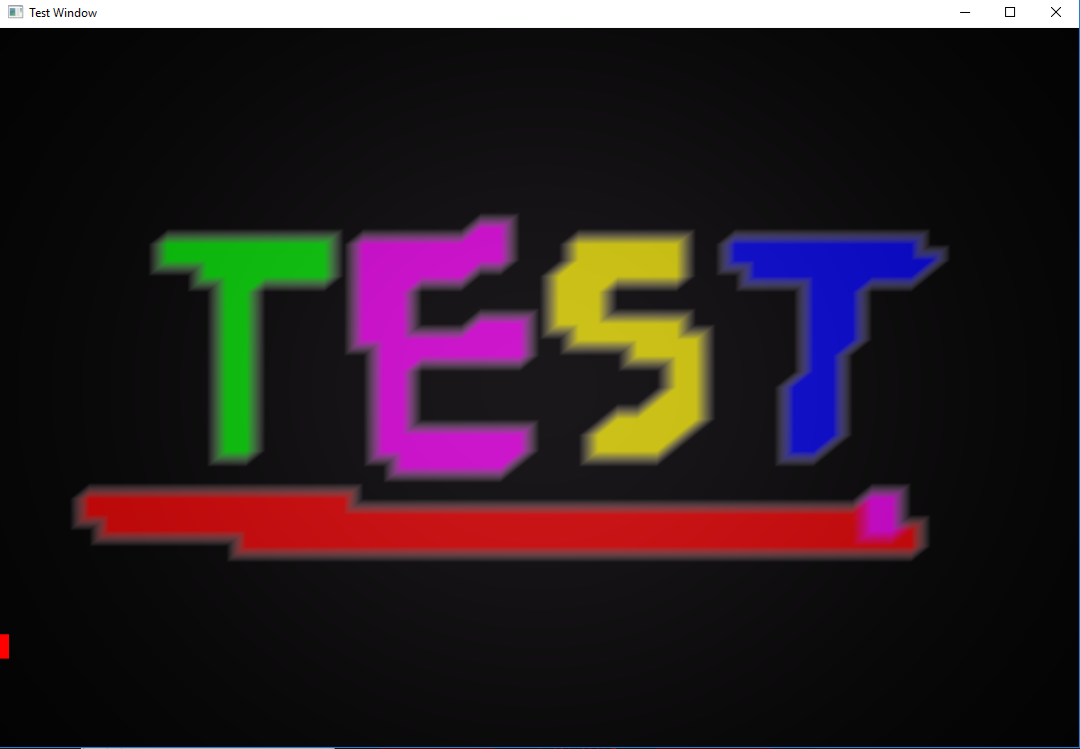
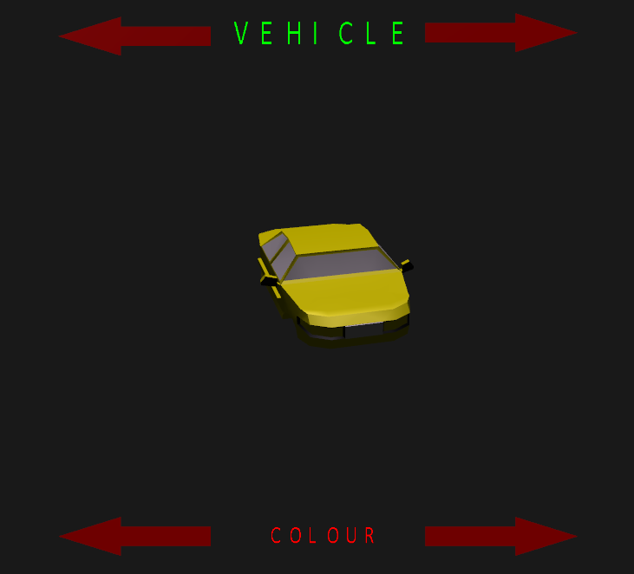
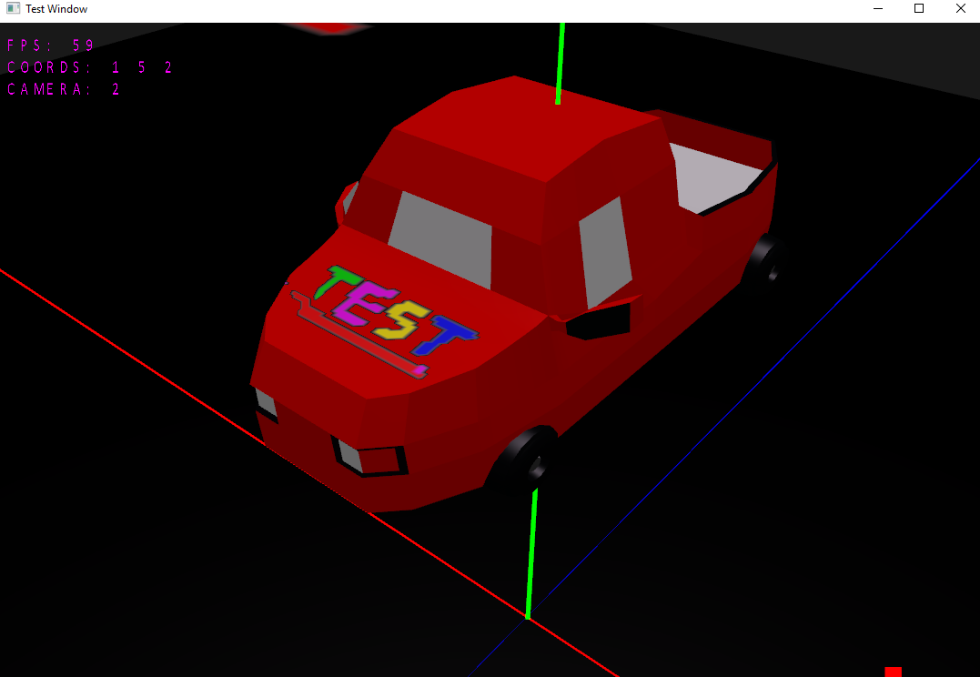
Game features - Alex
Vehicle/Hood customisation

Slide 16
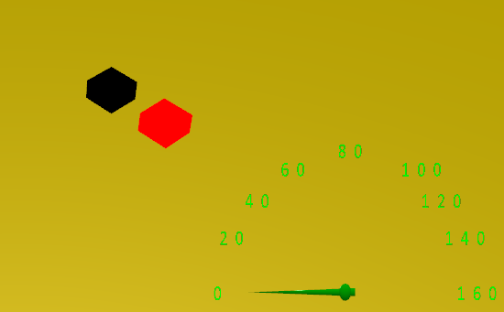
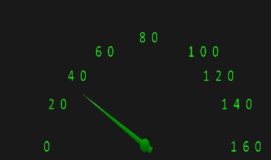
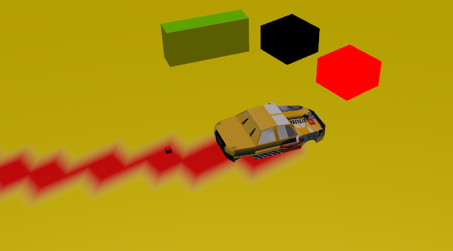
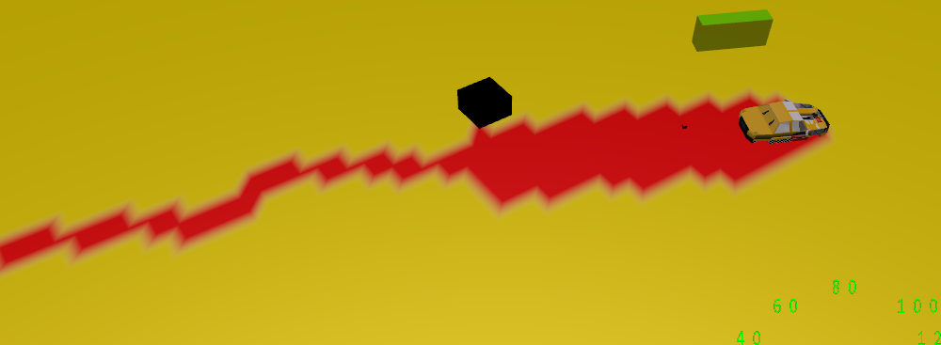
Game features - Alex
Miscellaneous (Timer/Power-ups/Speed gauge)

Slide 17
Game Features
Faizal
Notes:
Presenting by person

Slide 18
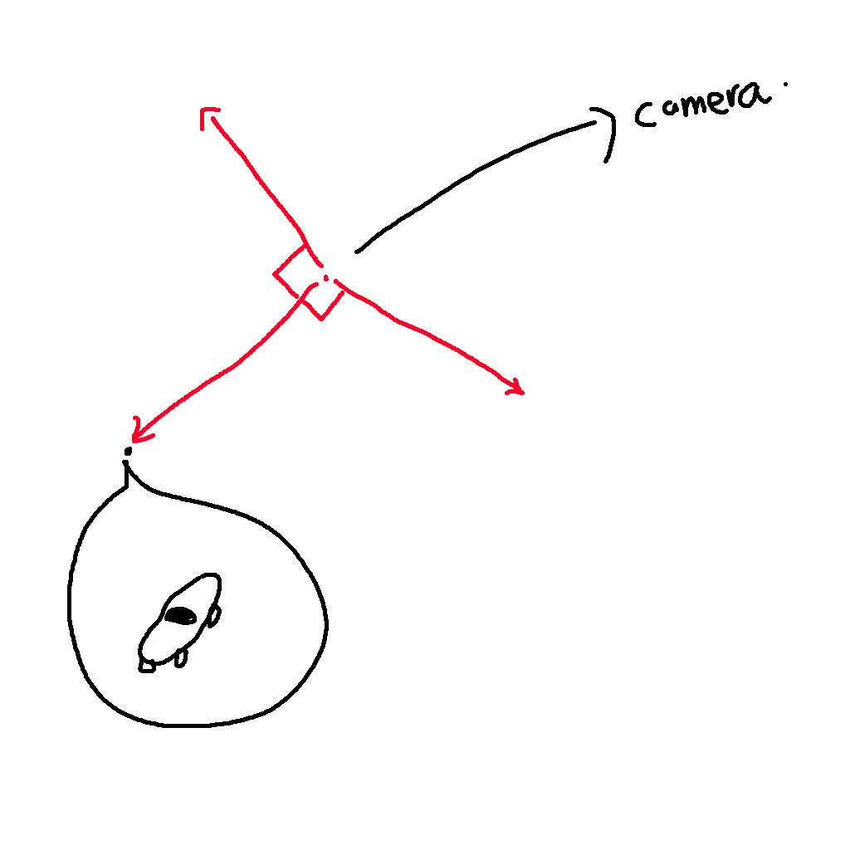
Game Features - Faizal
Notes:
Fill up yourself

Slide 19
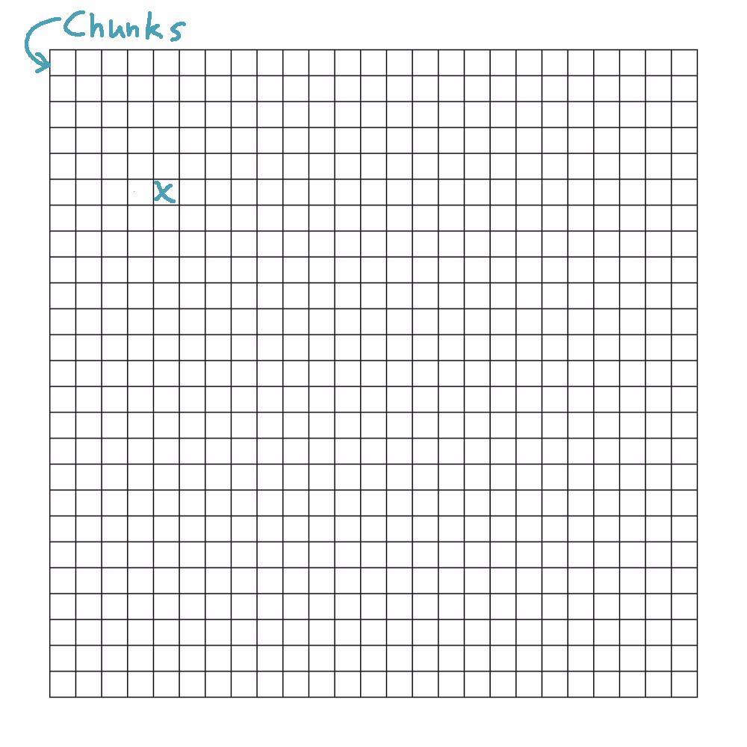
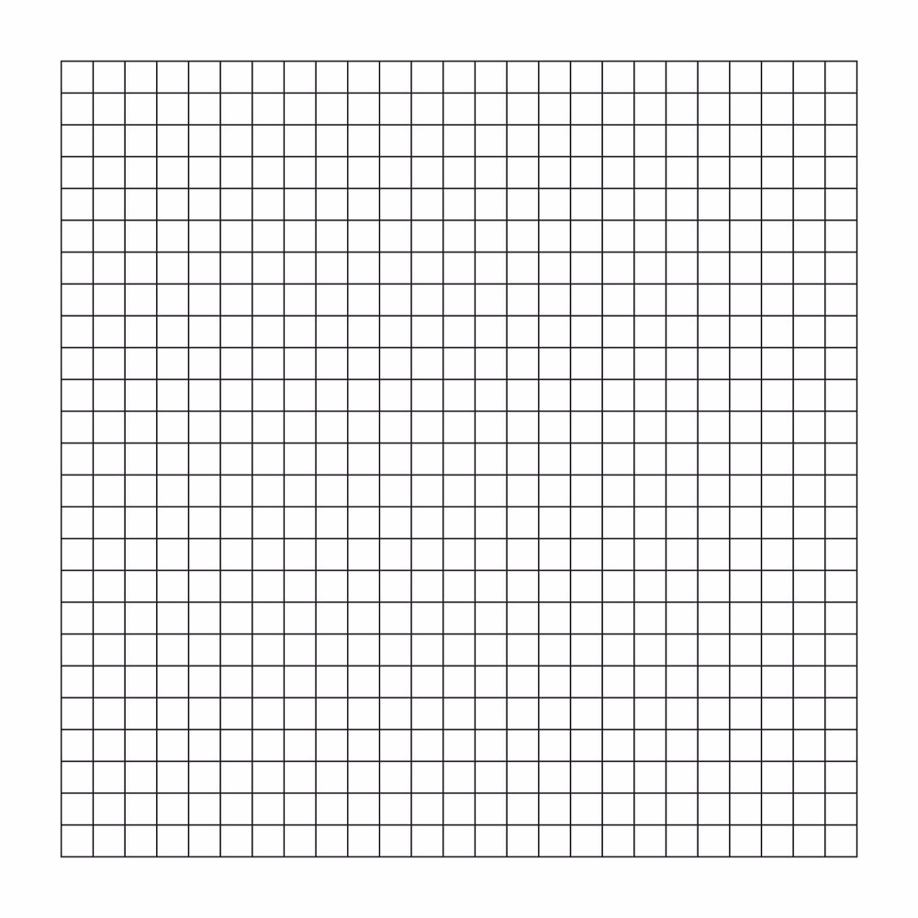
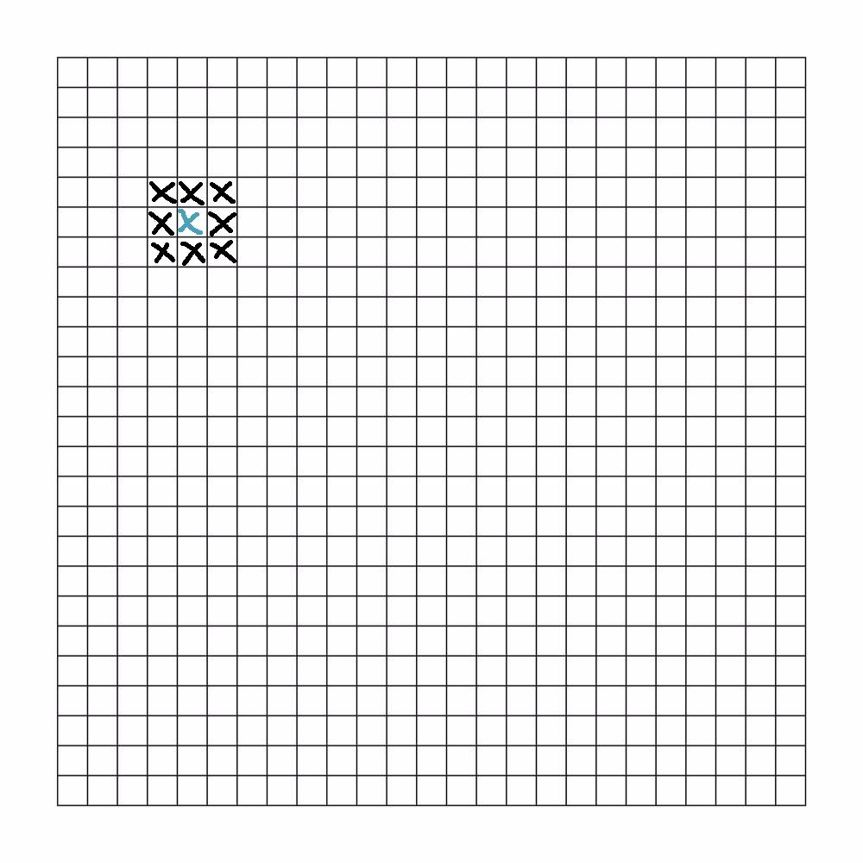
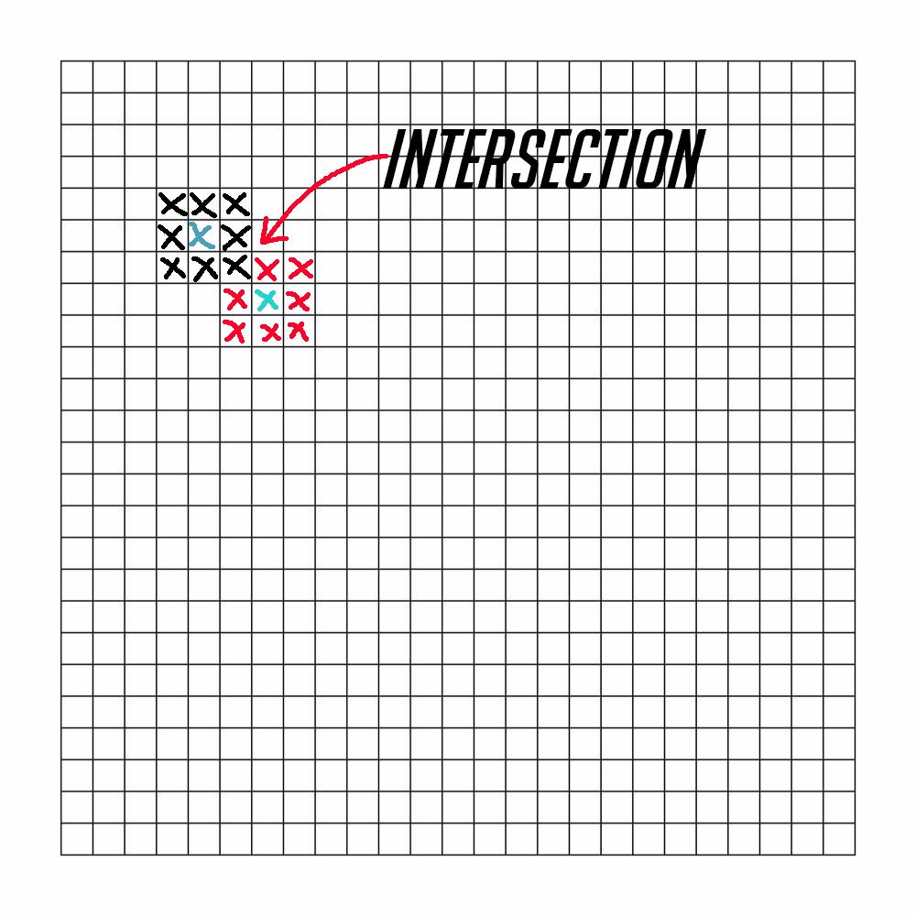
Game Features - Faizal
Random
Example
Adjacents
Notes:
Fill up yourself

Slide 20
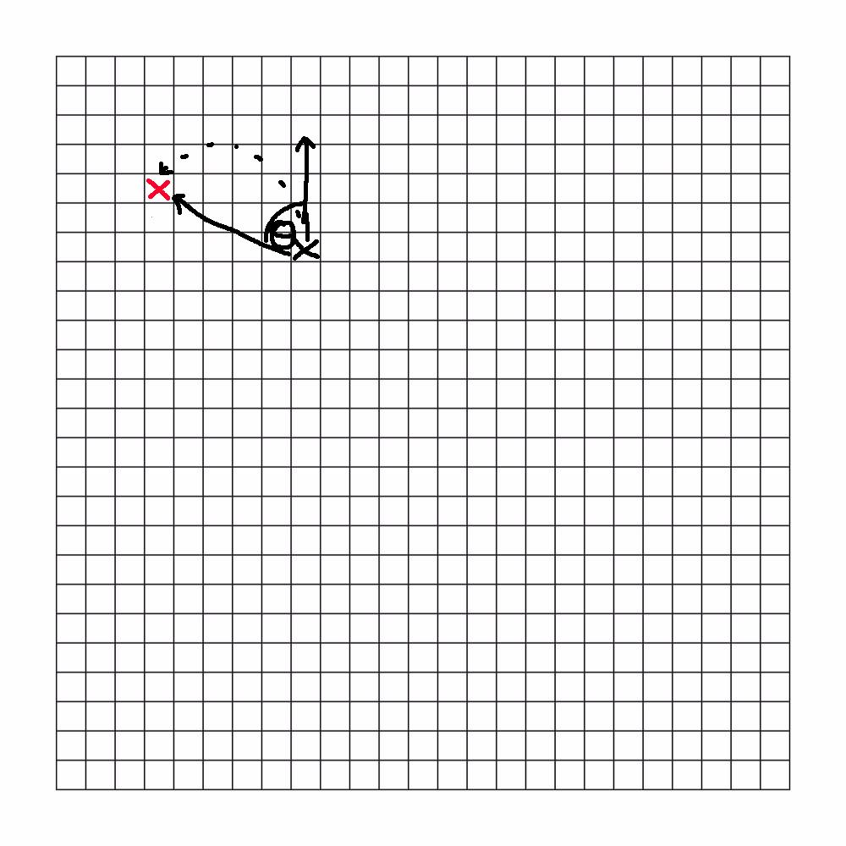
Game Features - Faizal
Angle > 5
!Occupied
Turn right
Move forward
Notes:
Fill up yourself

Slide 21
Game Features
Ko Sand
Notes:
Presenting by person

Slide 22

Game Features - Ko Sand
Static Friction = static coefficient x gravity x mass
Formula : F = ma
a = force - friction / mass
v = u + a * dt (Calculate final velocity)
s = v * dt (Update displacement)
u = v (Update initial velocity)
Engine Force
Kinetic Friction = kinetic coefficient x gravity x mass
Brake Friction
Drag Force
Notes:
Presenting by person

Slide 23

Game Features - Ko Sand
Turning Force
Formula : Fs = m v² / r
r = m v² / Fs (Calculate radius)
ω = v / r (Calculate omega)
θ = ω * dt (Update theta)
Notes:
Fill up yourself

Slide 24
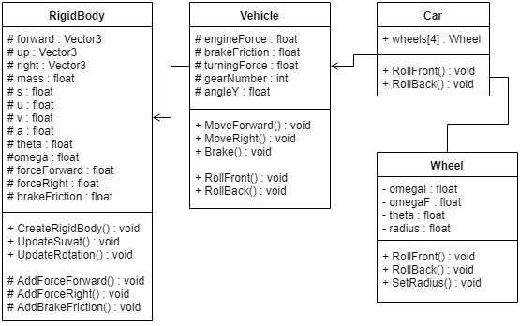
Game Features - Ko Sand

Slide 25
Game Features
Terence
Notes:
Presenting by person

Slide 26
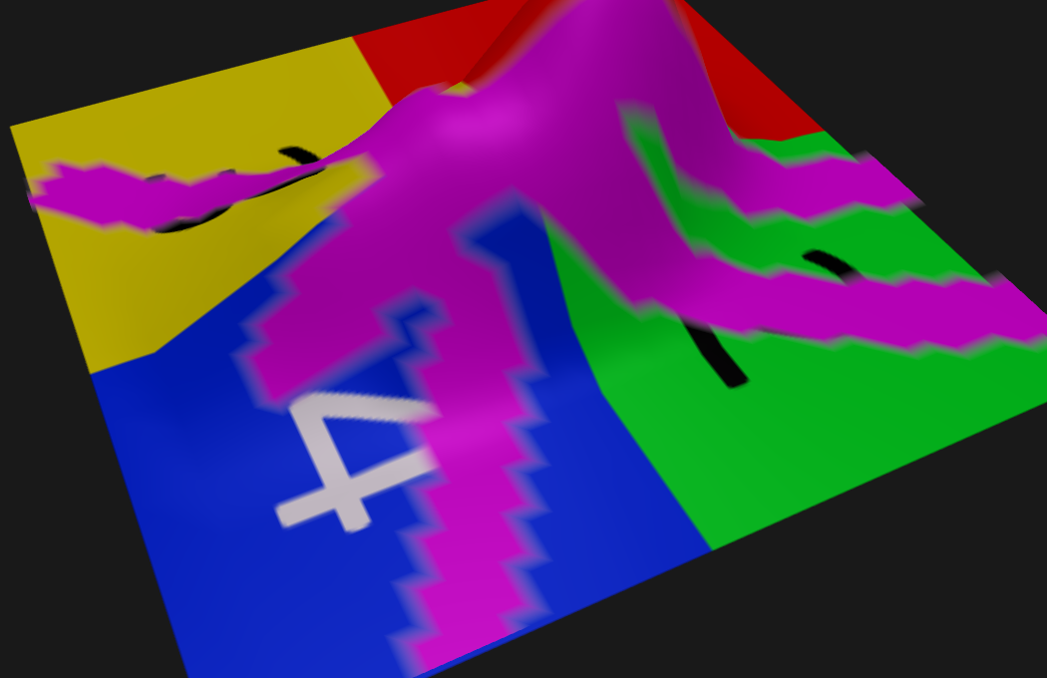
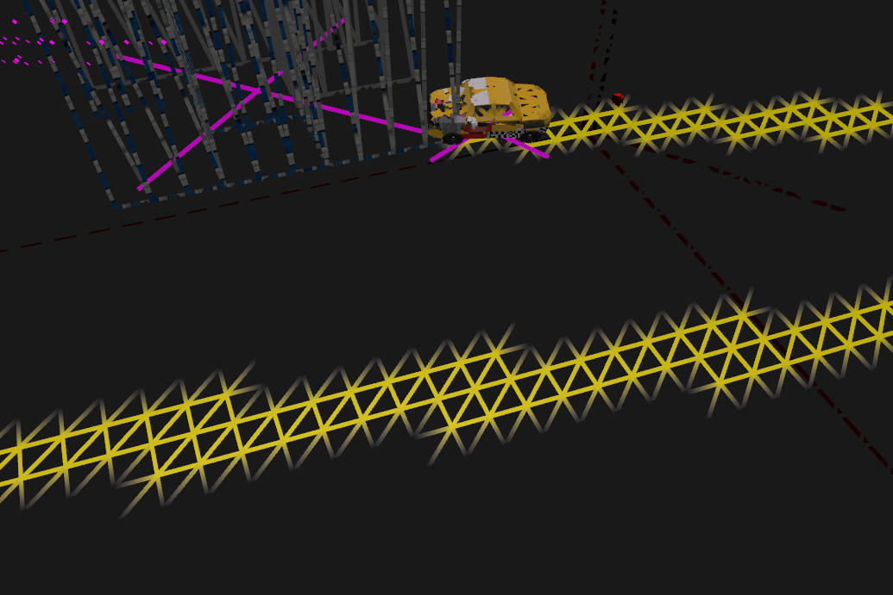
Game Features - Terence
Painting of meshes
Notes:
Presenting by person

Slide 27
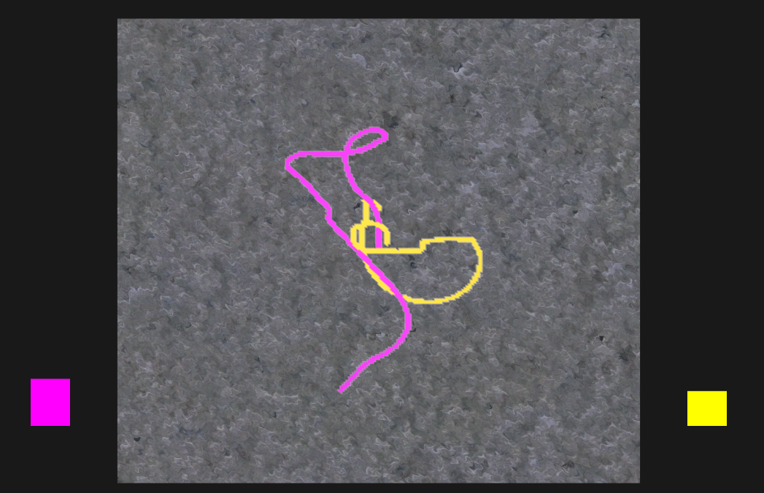
Game Features - Terence
Calculation of area of paint color
Notes:
Presenting by person

Slide 28
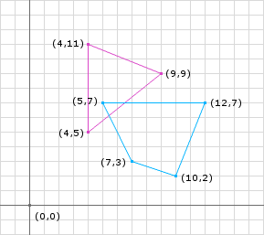
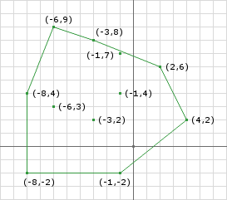
Game Features - Terence
Collision (with oriented colliders) done with GJK and EPA
Notes:
Presenting by person

Slide 29
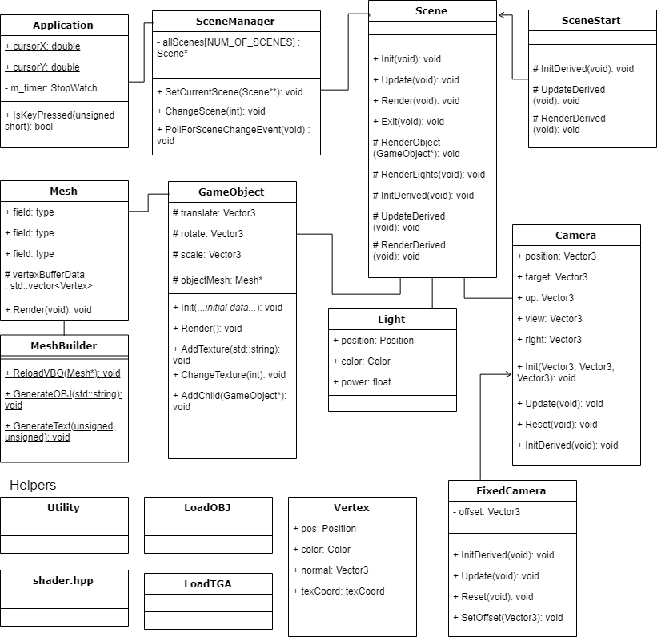
Game Features - Terence
...and framework stuff like GameObjects
Notes:
Presenting by person

Slide 30
Problems Faced
Dropped some features like shooting, due to lack of time - wish we scheduled by story points and not number of days
Didn’t take integration of all features into account when scheduling
3D collision unstable, and no time to fix, had to fallback to 2D
Possible unfound bugs in AI and collision, need more testing time

Slide 31
Future Improvements
Use tools like Trello to assign tasks
Create a testable minimum viable product earlier
Remove bugs
Make AI much more smarter
More levels/difficulty
Integrate different vehicle models into game scene + different types of vehicles

Slide 32
Q & A

Slide 33
Thank You

